Slide 1




EnerShare
Power From People
Project work Leadership&Innovation 2021 | Group 4
Notes:
Maybe bigger logos?

Slide 2
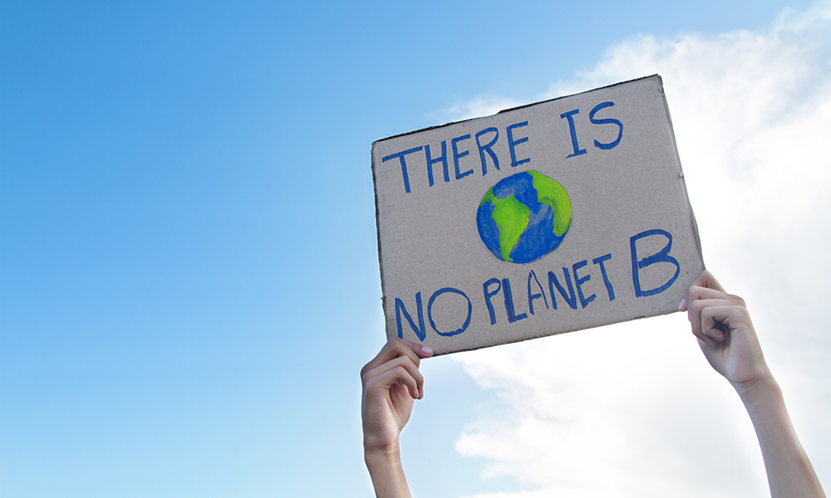

THE BIGGER PICTURE…
Why EnerShare → Inside EnerShare → How EnerShare
1
1
1
Notes:
Do we need a title here? Not sure… we could also leave it as it is

Slide 3




NEW ENERGY PARADIGM
Purpose Driven Business Canvas
Passion
Power from the people for the people
Vision
Fight the climate change
Purpose
Pervasive Peer to Peer distributed production network
Mission
Connect and foster Local Energy Communities birth and growth
Motivation
Low Environmental Impact Energy Production
Why EnerShare → Inside EnerShare → How EnerShare
2
2
1

Slide 4
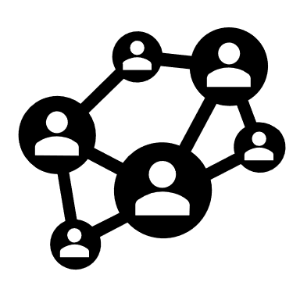



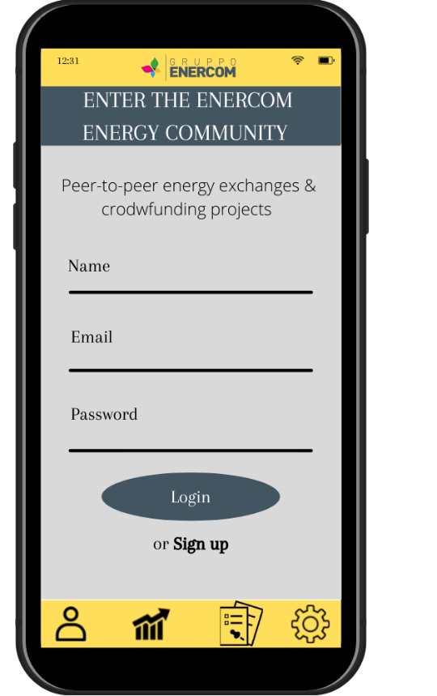
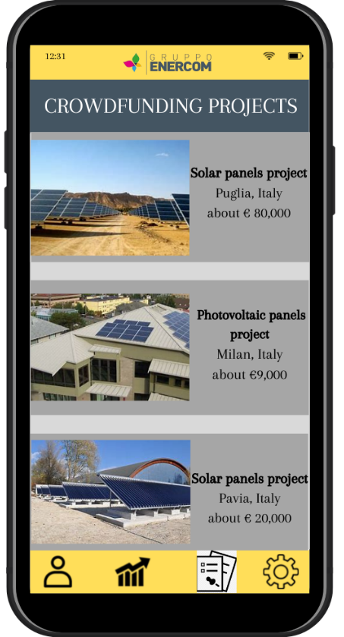
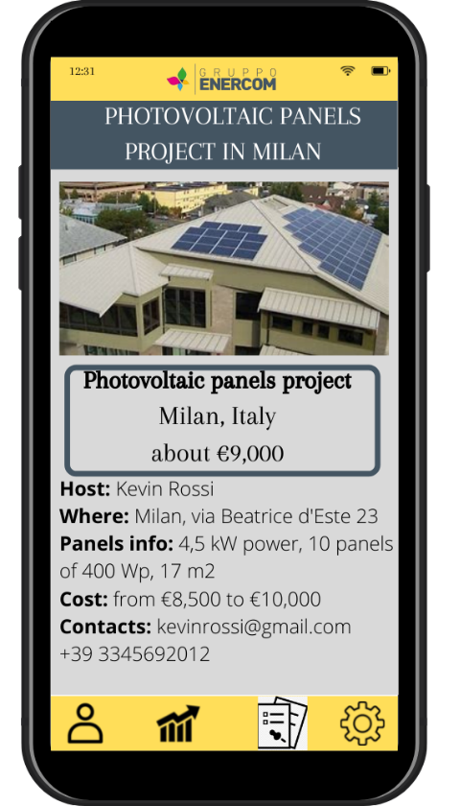
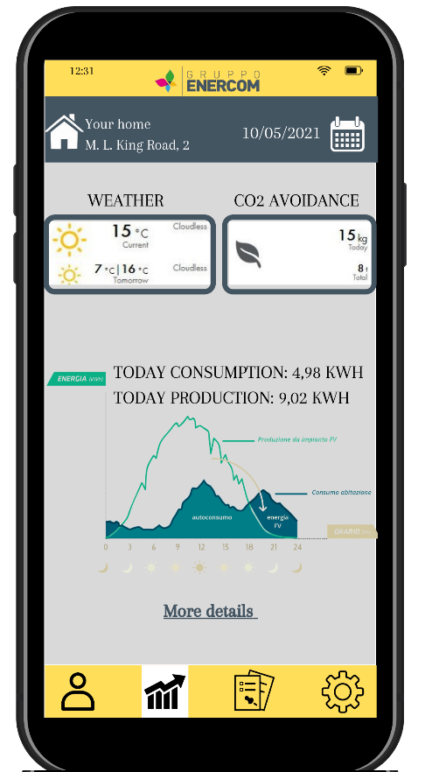
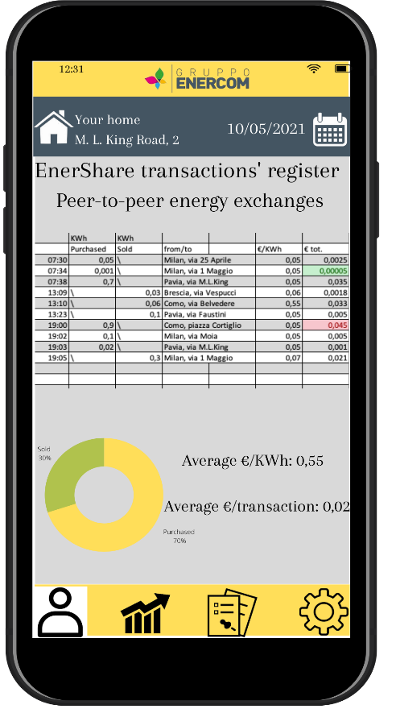

THE PLATFORM
>
Join the community
Match host and guest
Energy production
Energy exchange
More solar plants
Use of clean energy source
Enhance the surplus
Why EnerShare → Inside EnerShare → How EnerShare
3
1
3

Slide 5




CUSTOMERS
Investor
Host
Guest
Prosumer
Consumer
Why EnerShare → Inside EnerShare → How EnerShare
4
1

Slide 6
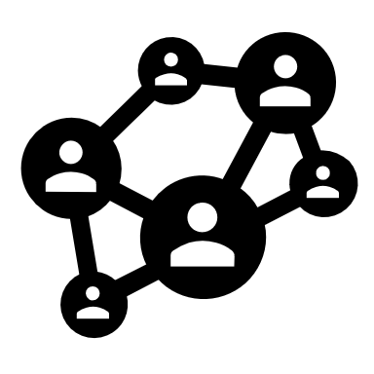

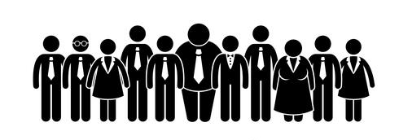






ENERGY COMMUNITY
Energy aware and sustainable communities
Crowdfunding
Scalability
EnerShare
Smart Contracts
Energy transition
Increase local support for renewable energy projects
Why EnerShare → Inside EnerShare → How EnerShare
5
5
1
1

Slide 7
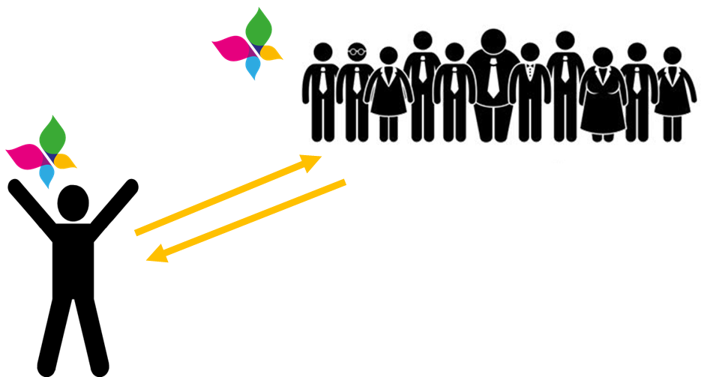
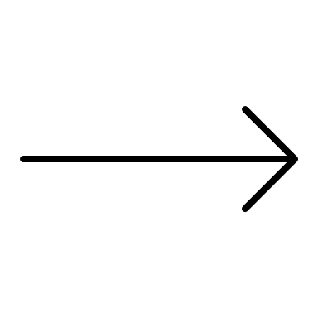

ENERGY TRADING
Prosumer
Consumer
Consumer
Prosumer
Why EnerShare → Inside EnerShare → How EnerShare
6
6
1

Slide 8
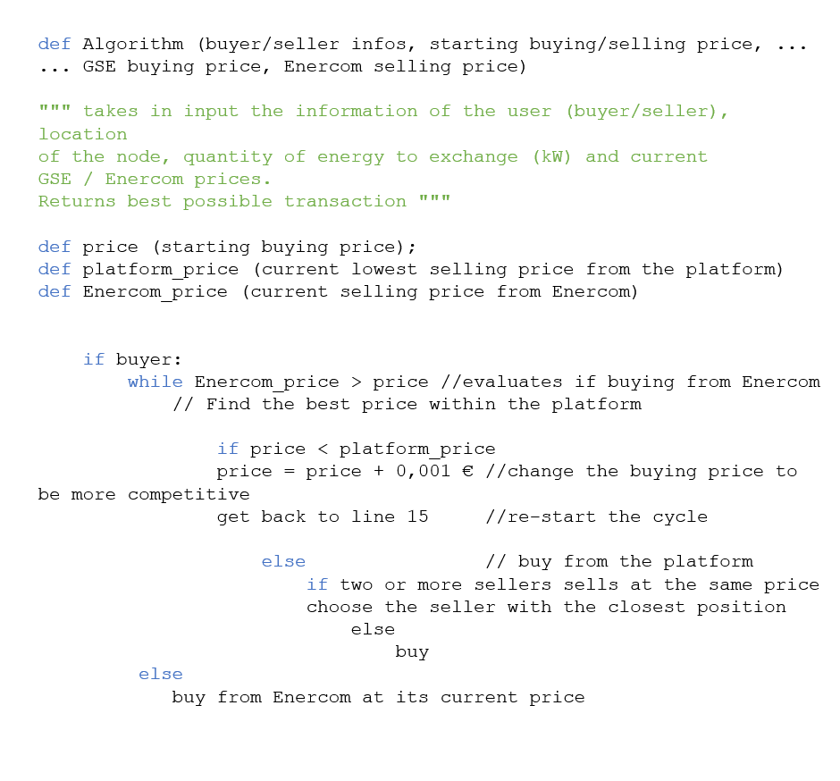
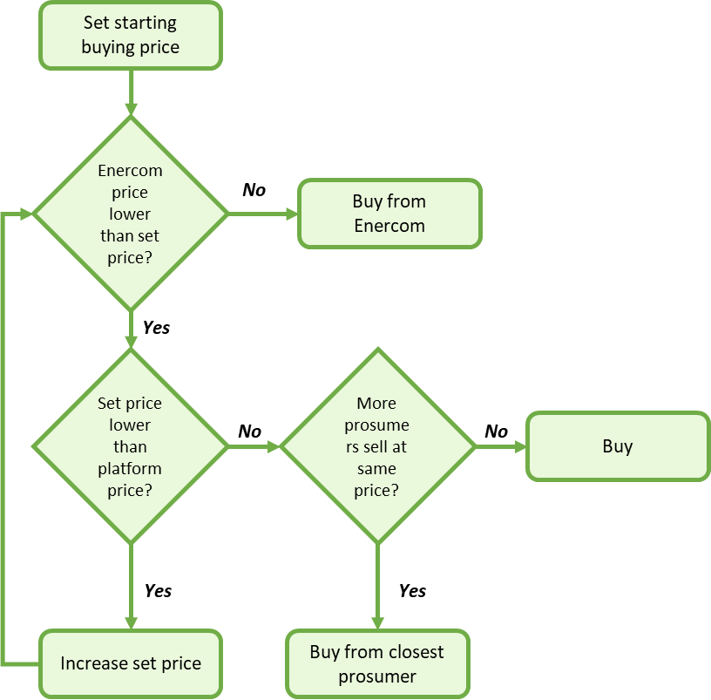
FLOW CHART & ALGORITHM
Buyer:
Why EnerShare → Inside EnerShare → How EnerShare
7
7
1

Slide 9




THE ROLE OF ENERCOM
CUSTOMERS SUPPORT
TECHNICAL CONSULTING
FINANCIAL CONSULTING
INSTALLATION
NEW ASSETS
Why EnerShare → Inside EnerShare → How EnerShare
8
1
Notes:
To sum up, Enercom's roles would be multiple: obviously it will be the owner and controller of the new software assets; it will follow and support the customer in the various phases of the journey; and back-end services such as project implementation, signing of Smart Contracts and physical installation.
The solution on the service side improves the perceived value to customers but also increases the customer base, this is what is called the positive network effect. In fact, each new user entry has the double effect of increasing Enercom's customer base and at the same time positively influencing the value of the platform by encouraging further potential entrants to join.

Slide 10








NUMBERS THAT MATTER
339.083.437
Euro
Raised in 2020 with crowdfunding
(+75% from 2019)
45,8
Years
Average age of a crowdfunder
880.090
Plants
Installed photovoltaic plants in Italy in 2019
70%
Average energetic surplus
57%
Forecasted saving in bills of a prosumer
530
Kg/y
average CO2 saved by a single plant
1M Euro
Estimated NPV, with a break even point at third year
Why EnerShare → Inside EnerShare → How EnerShare
9

Slide 11
EXPONENTIAL GROWTH
1
COMMUNITY & CROWDS
2
ALGORITHMS
CRITICAL MASS
EASIER LEGAL CONSTRAINS CONTEXT
3
LEAN ASSET AND STAFF
CONTINUOS DATA DRIVEN INNOVATION
A NEW ENERGY PRODUCTION PARADIGM
4
POSITIVE FEEDBACKS LOOPS
Why EnerShare → Inside EnerShare → How EnerShare
10

Slide 12




ACHIEVED RESULTS
ENERCOM CHALLENGES
OUR GOALS
Transition from consumer to prosumer
SUSTAINABILITY
Use of renewable energy
Flattering the consumption curve
Small scale energy exchange models
Artificial intelligence
CUSTOMER RELATIONSHIP
Enlarging customer base
Getting younger customers
More effective/attractive web interface
Subscription business model
Customers’ sustainable behaviors
ECONOMIC
Low investment
Less seasonality in revenues
Why EnerShare → Inside EnerShare → How EnerShare
11
1
Notes:
Divideremmo a slide in due, da un lato i punti del brief di enercom che tocchiamo con la soluzione, cioè gli obiettivi della compagnia; dall’altro lato i nostri obiettivi: sostenibilità, customer relationship, …, e questi due elenchi di obiettivi vengono raggiunti tramite enershare. In mezzo metteremmo il logo di enershare che unisce le due cose

Slide 13


THANK YOU FOR THE ATTENTION!
Leeb Ciantelli Maximilian
Mascolo Chiara
Paini Silvia
Parlak Ege Oguzhan
Patrizi Matteo
Poggiato Pietro
Portello Davide
Preti Carolina
12

